Slide 1

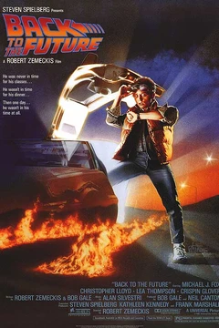


IMDB Movie Ratings Analysis
By: Rashaad Ratliff-Brown, Peter Barston, George Schinkel, and Jacob Crisp
8/3/21

Slide 2
Introduction

Slide 3

Introduction to the Dataset
The data is a collection of IMDB’s top 1000 movies.
Information included: title of movie, year of release, runtime (in minutes), genre, IMDB rating, IMDB metascore, a brief synopsis of the movie, up votes for the movie and box office gross.
Group added an “Era” variable
Data cleaned via Python and R to remove any NA values -> 747 observations.

Slide 4
Scenario Overview
With the summer blockbuster season in full swing and movie theaters reopening across the world, we are once again faced with the age-old question: are today’s movies as good as they were “back in the day”?
Whether it’s your parents complaining about the runtime of movies today or it’s your snobby friend remarking that the Golden Age of cinema has come and gone, data from IMDB can help us determine where we are historically.
With our application we hope to provide a tool to help users compare past movie hits with current movies to see how they stack up.
Our application was built to be scalable... so that if we had a larger movie data set these visuals would still work

Slide 5
Visuals - Overview:
The group split the data into chunks by year and by era of release to visualize the following:
Peter: Average runtime
Rashaad: Violin plot of IMDB ratings
George: Synopsis word cloud
Jacob: Average IMDB votes

Slide 6
Our RShiny App

Slide 7
Conclusion

Slide 8
Areas for Future Improvement
Compare TV show ratings
Incorporate consumption of other forms of entertainment over time
Sentiment analysis

Slide 9
Sources
IMDB Movie Ratings Database from Kaggle.com. By Preet Viradiya. https://www.kaggle.com/preetviradiya/imdb-movies-ratings-details

Slide 10
Questions?

